Slide 1
Iterator Pattern

Slide 2
Background
Traversing through elements in an aggregation is a very common problem in programming:
  Iterators provide a uniform way of doing this …
Using an iterator, we don’t need to know:
  How the collection is implemented!
  Concurrent access and Synchronization
  Different methods for iterating

Slide 3
Iterator Pattern: Intent
Provides a way to access the elements of an aggregate object sequentially:
  Without exposing the programmer to the complexity of underlying representation.
Moves the responsibility for access and traversal:
  From the aggregate object to an iterator object.

Slide 4
Iterator Pattern: Pros
Supports the same interface for all aggregates.
Supports multiple types of traversals of aggregate objects.
Supports multiple iterators…

Slide 5
Iterator: Essential Idea
The elements of a collection:
  Accessed in some sequential order that may be independent of their position in the collection.
For example:
  Level order: Access each object of a tree from left to right at each tree level
  Inorder, post order, preorder, etc

Slide 6
The Iterator Pattern: Context
It might be necessary to have more than one type of traversal on the same aggregate object.
  Also, not all types of traversals can be anticipated a priori.
One should not bloat the interface of an aggregate object with all possible traversals.

Slide 7
Iterator: Basic Methods
Reset:
  Move to the beginning of the range of elements
next:
  Advance to the next element
Get:
  Return the value referred to
hasNext:
  Interrogate it to see if it is at the end of the range

Slide 8
Iterator: Two Most Common Methods
public boolean hasNext()
  Returns true if the Iterator object has more elements (objects) that have not yet been returned by next()
public Object next()
  Returns the next element (object) from the iteration and advances to next element.

Slide 9
Additional Methods
Remove: Current element is removed, as in Java List.
Add: Add an element at the current position.
Count: Return the number of elements in the aggregate.
First: Reset

Slide 10
next() in Java: Issues
Theoretically, when an iterator returns an element of the collection:
  It might return a clone of the element, or it might return a reference to the element
Iterators for Java collection classes ArrayList<T> and HashSet<T>:
  Actually return references
Therefore, modifying the returned value will modify the element in the collection

Slide 11
Iterator Pattern: Main Idea
List
ListIterator
Count()
Append(Element)
Remove(Element)
…
First()
Next()
hasNext()
get()
index

Slide 12
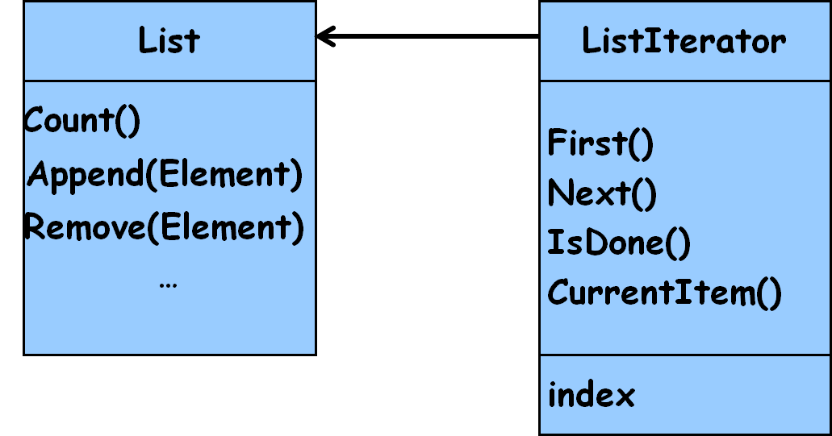
Iterator Pattern: Solution
The responsibility for accessing and traversing an aggregation object:
  Placed in a separate iterator object and not in the aggregate object.
An iterator object should:
  Provide the same interface for accessing and traversing elements,
  Regardless of the class of the aggregate object and the kind of traversal performed

Slide 13
Structure of Iterator Pattern
Aggregate
Iterator
CreateIterator()
first()
next()
hasNext()
get()
ConcreteAggregate
ConcreteIterator
CreateIterator()
return new ConcreteIterator()
A ConcreteIterator object holds a reference to the ConcreteAggregate object that created it.

Slide 14
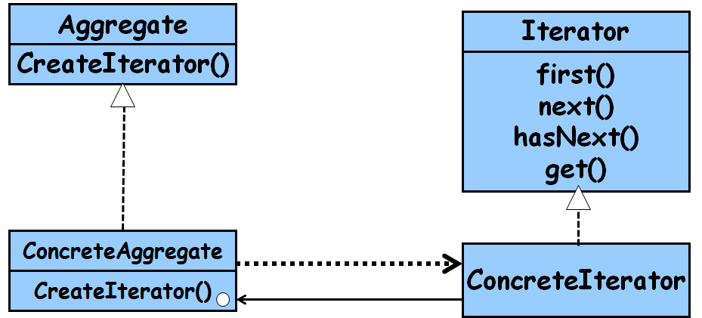
Iterator: Participants
Iterator
  Defines an interface for accessing and traversing elements
ConcreteIterator
  Implements the Iterator interface.
  Keeps track of current position in the aggregate.
Aggregate
  Defines an interface for creating an Iterator object
ConcreteAggregate
  Creates and returns an instance of the ConcreteIterator

Slide 15
Iterator
Design: Example
Iterator
{abstract}
first() : Item
next() : Item
hasNext() : Bool
ArrayIterator
LinkListIterator
first() : Item
next() : Item
hasNext() : Bool
first() : Item
next() : Item
hasNext() : Bool
Item
Array
LinkList
*
*

Slide 16
Iterator: Example
public String first() {
index = 0;
return data[0];
}
public String next() {
index++;
return data[index];
}
public boolean hasNext() {
if (index >= data.length)
return false;
return true;
}
}
public class ArrayIterator implements Iterator {
private String[] data;
private int index;
public ArrayIterator (String[] data) {
this.data = data;
this.index = 0;
}

Slide 17
Iterator Design: Example cont...
public class LinkListIterator implements Iterator {
private LinkListElement first;
private LinkListElement current;
public LinkListIterator (LinkListElement first){
this.first = first;
this.current = first;
}
public String first() {
return first.value();
}
public String next() {
current = current.getNext();
return current.value();
}
public boolean moreElements() {
if (current.getNext() == null)
return false;
return true;
}
}

Slide 18
Iterating Through A Vector: without Iterator
import java.util.*;
public class IterationExample1{
public static void main(String args[]) {
Vector v = new Vector();
// Put some Complex number objects in the vector.
v.addElement(new Complex(3.2, 1.7));
Continued…

Slide 19
Iterating Through A Vector
v.addElement(new Complex(7.6));
v.addElement(new Complex());
v.addElement(new Complex(-4.9, 8.3));
for (int i = 0; i < v.size(); i++) {
Complex c = (Complex)v.elementAt(i);
System.out.println(c);}
}
}

Slide 20
Iterating Through A Vector
For vectors this approach does not appear too bad:
  Because the elements of a vector can be retrieved by specifying their position:
  v.elementAt(i);

Slide 21
Iterating Through a Vector: Using Iterator
Iterator i = v.iterator();
while (i.hasNext()) {
Complex c= (Complex)i.next();
System.out.println(c);
}

Slide 22
Iterator for Java Collection
Iterator
hasNext()
next()
Collection
iterator()
ConcreteCollection
iterator()
ConcreteIterator
hasNext()
next()
<<create>>
return new ConcreteIterator()

Slide 23
Iterator in Java
When we look through the documentation for the Java:
  Support for the iterator pattern provided in the Java SDK is based on Iterator interface:
  Not abstract class (why?)
    public interface Iterator {
    public boolean hasNext();
    public Object next();
    public void remove();
    }

Slide 24
GOF Iterator Pattern in Java
An Iterator object is an instance of a class that implements the Iterator interface:
  Java Iterator interface defines the hasNext(), next(), and remove() methods…

Slide 25
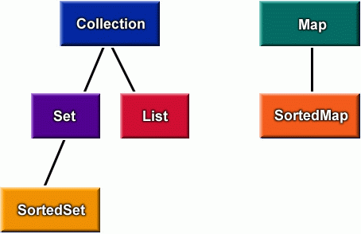
Java Collections

Slide 26
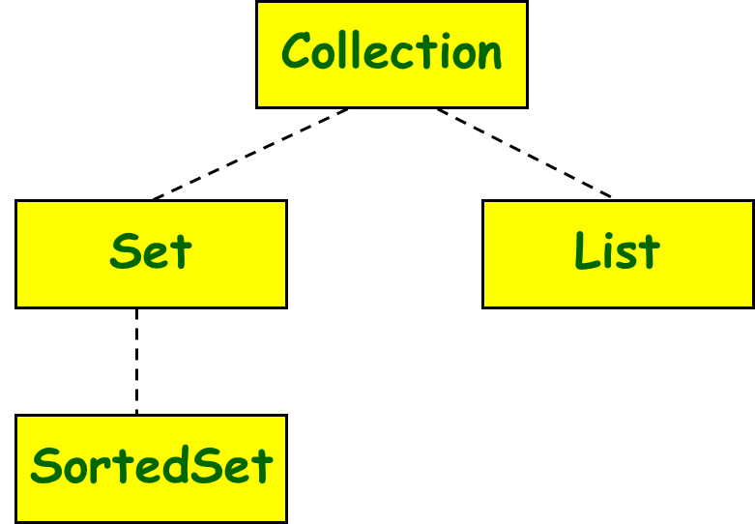
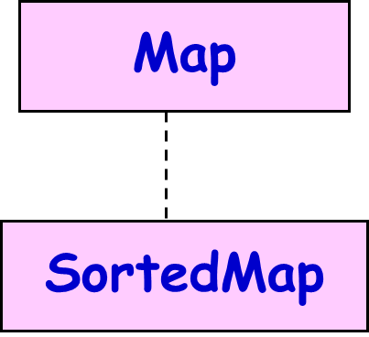
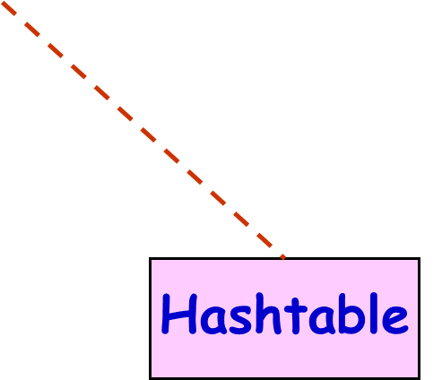
Java Collections
Hashtable is an old (pre-Collections) class
Hashtable has been retrofitted to implement the Map interface

Slide 27
«interface»
Collection
«interface»
Map
«interface»
Set
«interface»
Queue
«interface»
SortedMap
«interface»
List
HashSet
«interface»
SortedSet
Vector
ArrayList
LinkedList
TreeMap
HashMap
Linked
HashSet
TreeSet

Slide 28
Iterating Through a Hashtable
Hashtable does not implement Collection:
  Therefore does not have methods that return Iterator object for the keys and values in the table
Instead:
  entrySet() returns the Set of entries
  keySet() returns a Set of the keys in the table
  values() returns a Collection of the values in the table
  iterator() can be invoked on these collection objects

Slide 29
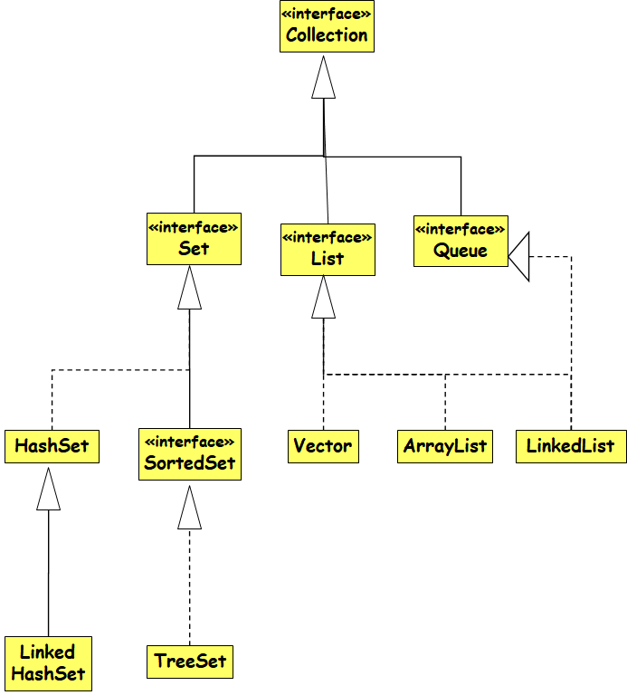
Iterator interface in Java
  public interface java.util.Iterator {
  public boolean hasNext();
  public Object next();
  public void remove();
  }
  public interface java.util.Collection {
  ... // List, Set extend Collection
  public Iterator iterator();
  }
  public interface java.util.Map {
  ...
  public Set keySet(); // keys,values are Collections
  public Collection values(); // (can call iterator() on them)
  }

Slide 30
The List Interface
java.util.List interface:
public interface List extends Collection {
Object get(int index);
Object set(int index, Object element);
void add(int index, Object element);
Object remove(int index);
boolean addAll(int index, Collection c);
int indexOf(Object o);
int lastIndexOf(Object);
ListIterator listIterator();
ListIterator listIterator(int index);
List subList(int from, int to);
}
Skip

Slide 31
The ListIterator Interface
java.util.ListIterator interface:
public interface ListIterator extends Iterator {
boolean hasNext();
Object next();
boolean hasPrevious();
Object previous();
int nextIndex();
int previousIndex();
void remove();
void set(Object o);
void add(Object o);
}
Skip

Slide 32
Iterators in Java
All Java collections have a method iterator that returns an iterator for the elements of the collection
List list = new ArrayList();
... add some elements ...
for (Iterator itr = list.iterator(); itr.hasNext()) {
BankAccount ba = (BankAccount)itr.next();
System.out.println(ba);
}
set.iterator()
map.keySet().iterator()
map.values().iterator()

Slide 33
Adding your Own Iterators
When implementing your own data structures, it can be very convenient to use Iterators
  public class PlayerList {
public int getNumPlayers() { ... }
public boolean empty() { ... }
public Player getPlayer(int n) { ... }
}
  public class PlayerList {
public Iterator iterator() { ... }
public int size() { ... }
public boolean isEmpty() { ... }
}
Discouraged Nonstandard interface.
  Preferred

Slide 34
Implementing an Iterator
Three main approaches to create an Iterator for an aggregate class A:
  Use a separate class
  Use an inner class within A
  Use an anonymous inner class within A

Slide 35
Inner Iterator Class
Java allows one class to be nested inside another
Inner class has full access to private data of main class
  data is still kept as a private field

Slide 36
class LinkList {
private Node head;
// put all the usual stuff here
public class LLIterator implements Iterator {
private Node nextObject;
public LLIterator() {
nextObject = head;
}
}
public Iterator iterator() {
return new LLIterator();
}
}

Slide 37
A Few Issues
Who controls the iteration?
External:
  Client explicitly calls all necessary operations for traversal, e.g. client must explicitly request next() on each node
Internal:
  Client asks the internal iterator an operation to perform, and the iterator applies that operation to every element…

Slide 38
An external iterator is active, an internal is passive. When the client (i.e. the programmer) controls the iteration, the iterator is called external iterator. When the iterator controls it, it is called an internal iterator. ... Internal iteration is less error prone and more readable.
But,…

Slide 39
Pros and Cons
External Iterator:
  More flexible than Internal.
    Can compare 2 collections easily
Internal Iterator:
  Easier to use, as they define the iteration logic for you. Makes portability easier.

Slide 40
Iterator Pattern: Variations
Who defines the traversal algorithm?
  The iterator is not the only place where the traversal algorithm can be defined.
  The aggregate might define the traversal algorithm and use the iterator to store just the state of the iteration. (does not break encapsulation)
  This is called a cursor approach
A client will invoke the next operation on the aggregate with the cursor as an argument:
  The next operation will change the state of the cursor.

Slide 41
Multiple Traversal Algorithms
Complex aggregates may be traversed in many ways.
    For example, construction of parse tree may require inorder traversal
    Semantic checking may involve traversing parse tree pre-order or post-order.
    Code generation may traverse the parse tree post-order.
    Iterators make it easy to change the traversal algorithm: Just replace the iterator instance with a different one

Slide 42
Traversal Issues
If the iterator is responsible for the traversal algorithm:
  It becomes easy to use different iteration algorithms on the same aggregate
  It is easy to reuse the same algorithm on different aggregates.
But, the traversal algorithm might need to access private data of the aggregate.:
  Putting the traversal algorithm in the iterator violates the encapsulation of the aggregate.

Slide 43
Implementation Issues
How robust is the iterator?
  It can become dangerous to modify an aggregate (elements are added or deleted ) while you're traversing it.
  Why not just make a copy?
  A robust iterator ensures that insertions and removals won't interfere with traversal, and it does it without copying the aggregate.

Slide 44
Implementation Issues
There are many ways to implement robust iterators.
  Most rely on registering the iterator with the aggregate.
On insertion or removal:
  The aggregate either adjusts the internal state of iterators it has produced,
  Or it maintains information internally to ensure proper traversal.

Slide 45
Iterator: Final Analysis
Programmer gets a consistent interface to traverse any collection…
It is easy to have multiple iterators traversing the same collection.
Flexibility: An iterator can give access to a filtered view of the items in a collection…

Slide 46
Exercise: Design and Write Code for CircularList Iterator
CircularListIterator
implements the
Iterator interface
Iterator
CircularList
CircularList
Iterator
A CircularListIterator object holds a reference to the CircularList object that created it.

Slide 47
Using the CircularList Iterator …
CircularList l = new CircularList();
...
//store integers in the list
...
Iterator i = l.iterator();
while (i.hasNext()) {
System.out.println(i.next());
}

Slide 48
Solution: Class Structure
List
Iterator
CreateIterator()
First()
Next()
IsDone()
CurrentItem()
CircularList
ConcreteIterator
CreateIterator()
return new ConcreteIterator()
A ConcreteIterator object holds a reference to the CircularList object that created it.

Slide 49
Solution: Class CircularListIterator
class CircularListIterator implements Iterator {
public boolean hasNext() {}
public Object next() {}
public void remove() {}
}

Slide 50
Class CircularListIterator
class CircularListIterator implements Iterator{
private CircularList myList;
public CircularListIterator(CircularList
theList) { myList = theList; }
public Object next() {}
public boolean hasNext() {}
public void remove() {}
}
  // Constructor: Pass a reference to the CircularList object to CircularListIterator’s constructor

Slide 51
Class CircularListIterator
class CircularListIterator implements Iterator {
private CircularList myList;
// constructor not shown…
private int pos = 0;
public Object next() {
Object o = myList.get(pos);
// Update pos to indicate the position of the element that
// will be returned the next time this method is invoked.
pos++;
return o;
}

Slide 52
Class CircularListIterator
public boolean hasNext() {
return(pos < myList.count()); }
public void remove() {
if (pos > 0) {
myList.remove(pos-1);
// This method should throw an
// IllegalStateException if next() has not
// yet been invoked, or if remove() has
// already been invoked after the last
// invocation of next().
}

Slide 53
Modifying Class CircularList
All that remains now:
  Define a method in CircularList to create and return a CircularListIterator object
In order to be consistent with other Java collection classes:
  We'll call the method iterator()

Slide 54
Modifying Class CircularList
class CircularList{
public Iterator iterator() {
// Create a CircularListIterator object,passing
// it a reference to this CircularList object.
return new CircularListIterator(this);
}
}

Slide 55
Exercise: Polymorphic Iterators
Assume that we have an AbstractList class.
Based on this, we have List and SkipList implementations.
Design Iterators for these different implementations of the AbstractList.

Slide 56
AbstractList
CreatIterator()
Count()
Append(Item)
Remove(Item)
…
Client
Iterator
First()
Next()
IsDone()
CurrentItem()
List
ListIterator
SkipList
SkipListIterator

Slide 57
List list = new List();
SkipList skipList = new SkipList();
Iterator listIterator = list.CreateIterator();
Iterator skipListIterator = skipList.CreateIterator();
handleList(listIterator);
handleList(skipListIterator);
…
public void handleList(Iterator iterator) {
iterator.First();
while (!iterator.IsDone()) {
Object item = iterator.CurrentItem();
// Code here to process item.
iterator.Next();
}
}

